Slide 1
SQL Project 3 - Data Science
Chinook Music Database
SQLite3 + Python Pandas + Matplotlib | Google Colab
Srilatha Alla

Slide 2
What I Learned: SQLite3 Setup in Google Colab
Step 1 — Install & Verify
Two Ways to Query in Colab
%%bash apt-get install -y sqlite3 pip install sqlite-web !sqlite3 --version –- 3.37.2
A %%script sqlite3 magic (CLI output)
%%script sqlite3 --column --header chinook.db SELECT name FROM sqlite_master WHERE type='table';
Step 2 — Connect with Python
B pd.read_sql_query (DataFrame output)
import sqlite3 as db import pandas as pd
db_con = db.
connect("chinook.db")
query = "SELECT name FROM sqlite_master " df = pd.read_sql_query(
query, db_con)
Key insight: %%script shows raw CLI output; pd.read_sql_query returns a pandas DataFrame you can plot

Slide 3
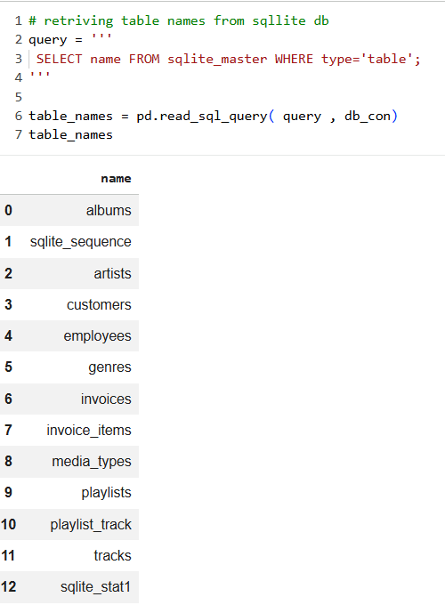
The Chinook Dataset
🎵
👥
🧾
🎸
11 Tables
59 Customers
412 Invoices
275 Artists
tracks, albums, artists
invoices, customers…
spanning 24 countries
globally
real purchase records
with line items
across multiple genres
and media types
Queried using SQLite3 + Python (sqlite3, pandas, matplotlib) in Google Colab

Slide 4

Challenging Query: Year Conversion - strftime
SQL
Result
#Which sales agent made the most in sales in 2010?
%%script sqlite3 --column --header chinook.db
SELECT
e.FirstName || ' ' || e.LastName AS SalesAgentName,
ROUND(SUM(i.Total), 2) AS TotalSales
FROM Employees e
JOIN Customers c
ON e.EmployeeId = c.SupportRepId
JOIN Invoices i
ON c.CustomerId = i.CustomerId
WHERE e.Title = 'Sales Support Agent'
AND strftime('%Y', i.InvoiceDate) = '2010'
GROUP BY e.EmployeeId, SalesAgentName
ORDER BY TotalSales DESC
LIMIT 1
Jane Peacock 3 -> 21 customers
What I Learned
JOIN links customers to employees on SupportRepId GROUP BY collapses rows per employee so COUNT returns per-rep totals

Slide 5
Query: BETWEEN + ORDER BY on Dates
SQL
Result (3 rows, ordered by DOB)
SELECT * FROM employees WHERE HireDate
BETWEEN '2002-05-01' AND '2003-10-18' ORDER BY BirthDate
Name | Title | Born
Margaret Park | Sales Support | 1947-09-19
Nancy Edwards | Sales Manager | 1958-12-08
Andrew Adams | General Mgr | 1962-02-18
What I Learned
BETWEEN works on ISO date strings (SQLite compares lexicographically) ORDER BY can sort on a different column than the WHERE filter
Both ends are inclusive — great for date range reports

Slide 6
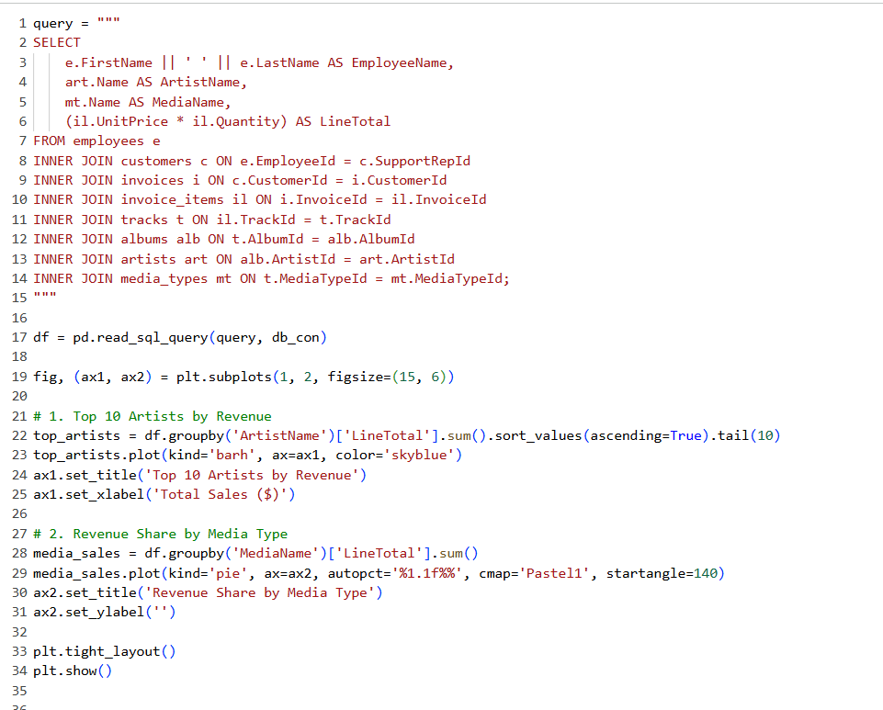
Visualizing SQLite Data: Chart Types
Joining 8 tables:
employees -> customers -> invoices -> items -> tracks -> albums -> artists -> media_types
Key insight:
every JOIN needs a matching FK/PK — mapping these correctly was the hardest part

Slide 7
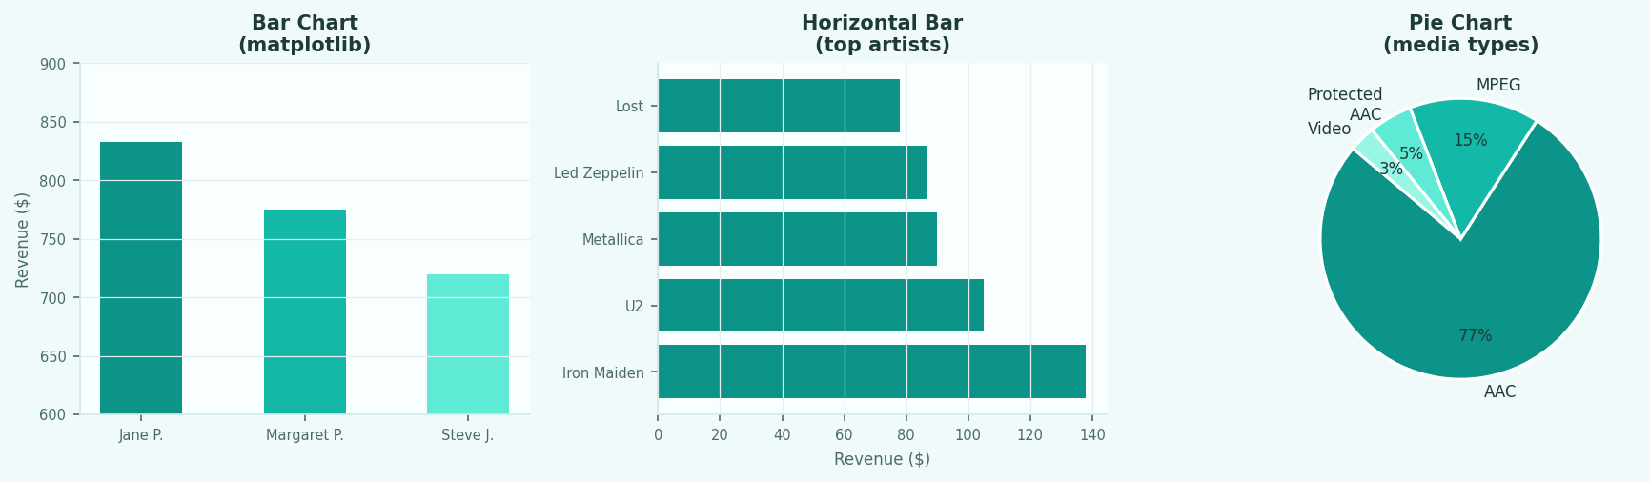
Visualizing SQLite Data: Chart Types
Bar, Horizontal Bar & Pie — all driven by SQL queries, rendered with matplotlib
SELECT + GROUP BY
JOIN across 4 tables
GROUP BY media type
employee revenue summed
per rep with SUM()
tracks -> albums -> artists
to rank by revenue
COUNT or SUM per
media_type name

Slide 8
Visualizing SQLite Data: Two Display Methods
SQLite results can be shown as a DataFrame table OR as a matplotlib chart
A pd.read_sql_query() — DataFrame Table
B %%script sqlite3 — CLI Output
df = pd.read_sql_query(query, db_con)
df
# displays styled table in Colab
%%script sqlite3 --column --header chinook.db SELECT firstname, sum(total) FROM ...
EmployeeName | TotalSales
Jane Peacock | $833.04
Margaret Park | $775.40
Steve Johnson | $720.16
FirstName LastName count ---------- -------- ----- Jane Peacock 21 Margaret Park 20 Steve Johnson 18
Best for: analysis, plotting, styled output
Best for: quick checks, readable raw output
Key difference: pd.read_sql_query() returns a plottable DataFrame; %%script sqlite3 prints columnar CLI text — can't be charted directly

Slide 9
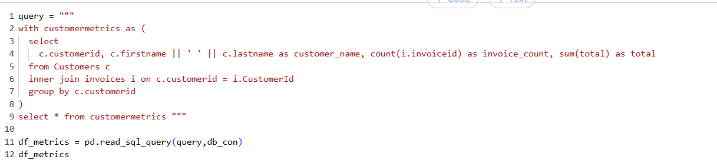
With
Common Table Expression (CTE)
What I Learned

Slide 10
Key Takeaways
01
SQLite3 in Colab — Install via apt-get, connect with Python's sqlite3 module — two ways to query
02
GROUP BY + JOIN — COUNT and SUM are meaningless without a GROUP BY dimension across joined tables
03
BETWEEN on dates — ISO date strings compare lexicographically — inclusive filtering made easy
04
Multiple viz methods — %%script for quick CLI output; pd.read_sql_query for plottable DataFrames
05
CTEs + multi-JOIN — Chaining 8 tables is possible — CTEs keep the logic readable and debuggable

